Slide 1


PROJECT EWA
Early Warning of Alzheimer
Nataliia Zozuk (PhD student)
Constantine the Philosopher University

Slide 2


21st CENTURY
IT WORLD
WORLD OF HEALTH
ARTIFICIAL INTELLIGENCE
NEURODEGENERATIVE DISEASES
MOBILE DEVICES
MACHINE LEARNING
NEURAL NETWORKS
ALZHEIMER‘S
DISEASE (AD)
PARKINSON‘S
DISEASE (PD)

Slide 3

NLP
Natural language processing
Main tasks:
text and speech processing
morphological analysis
syntactic analysis
lexical analysis
semantic analysis

Slide 4
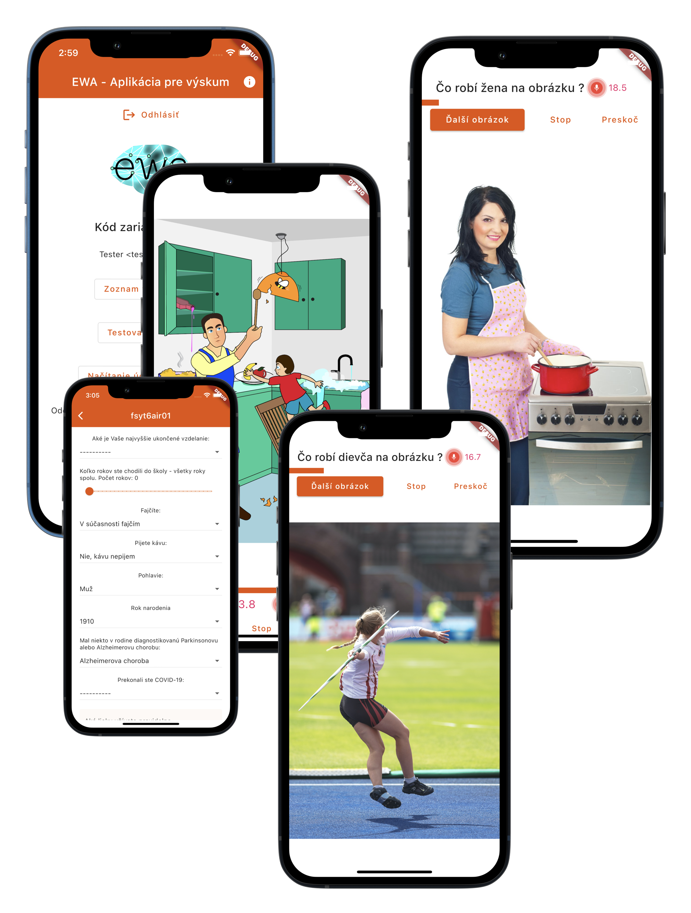
EWA project - application
The main goal - to develop a functional application for detecting early signs of neurodegenerative diseases, especially Alzheimer's disease.
Early detection of neurodegenerative disease has a high positive impact on several areas of life and society:
Health
Social
Economic

Slide 5
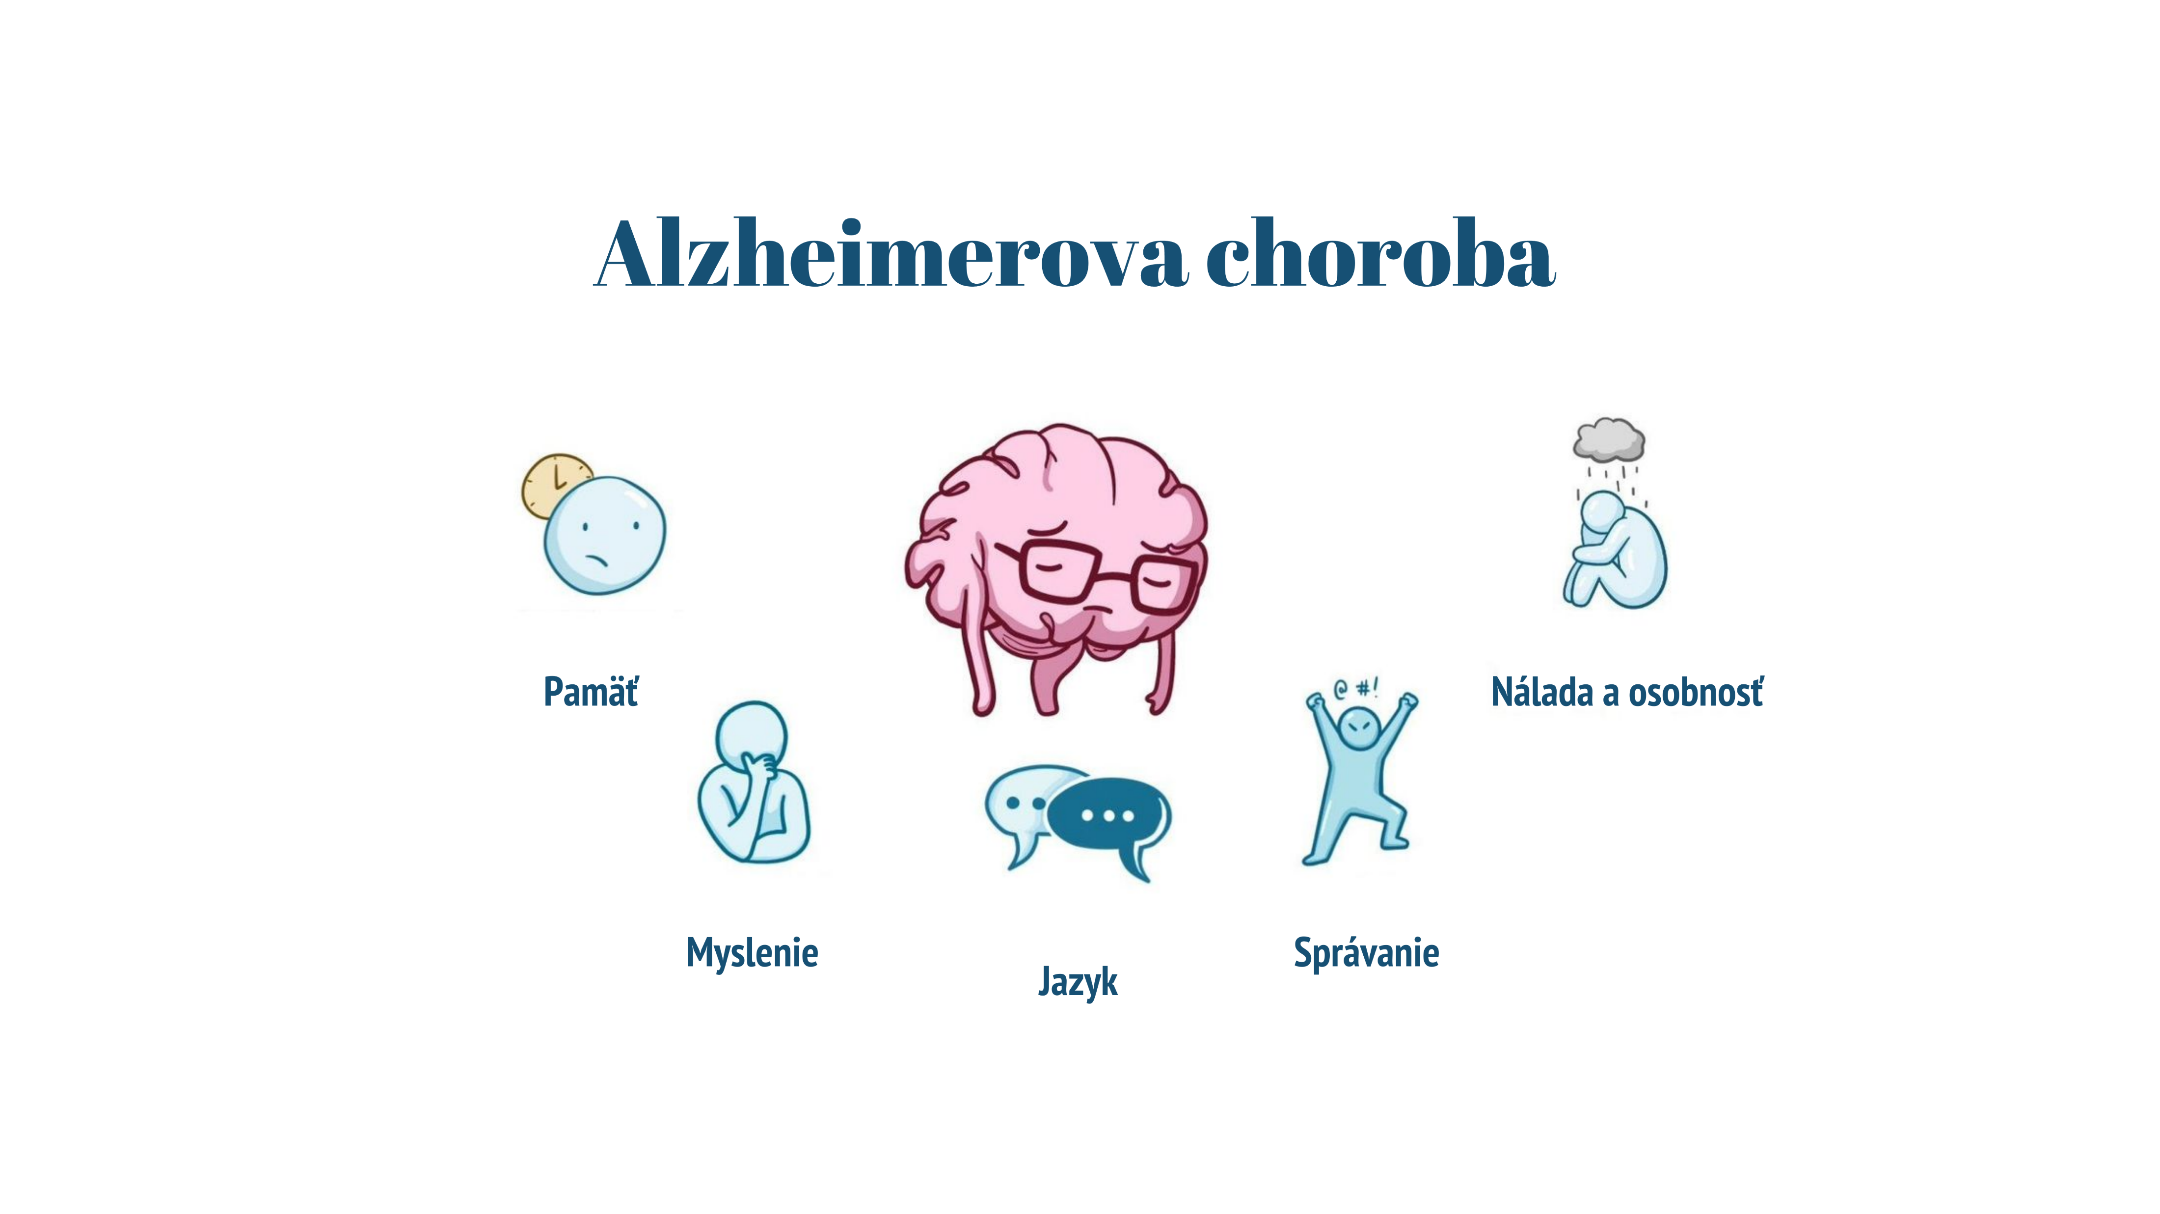
Alzheimer's disease
Memory
Mood and personality
Thinking
Behaviour
Language

Slide 6

Main areas of the research project
Neurological - psychological part
Acoustic analysis
Speech-to-text and its analysis by NLP methods
Machine learning with artificial intelligence methods, classification

Slide 7





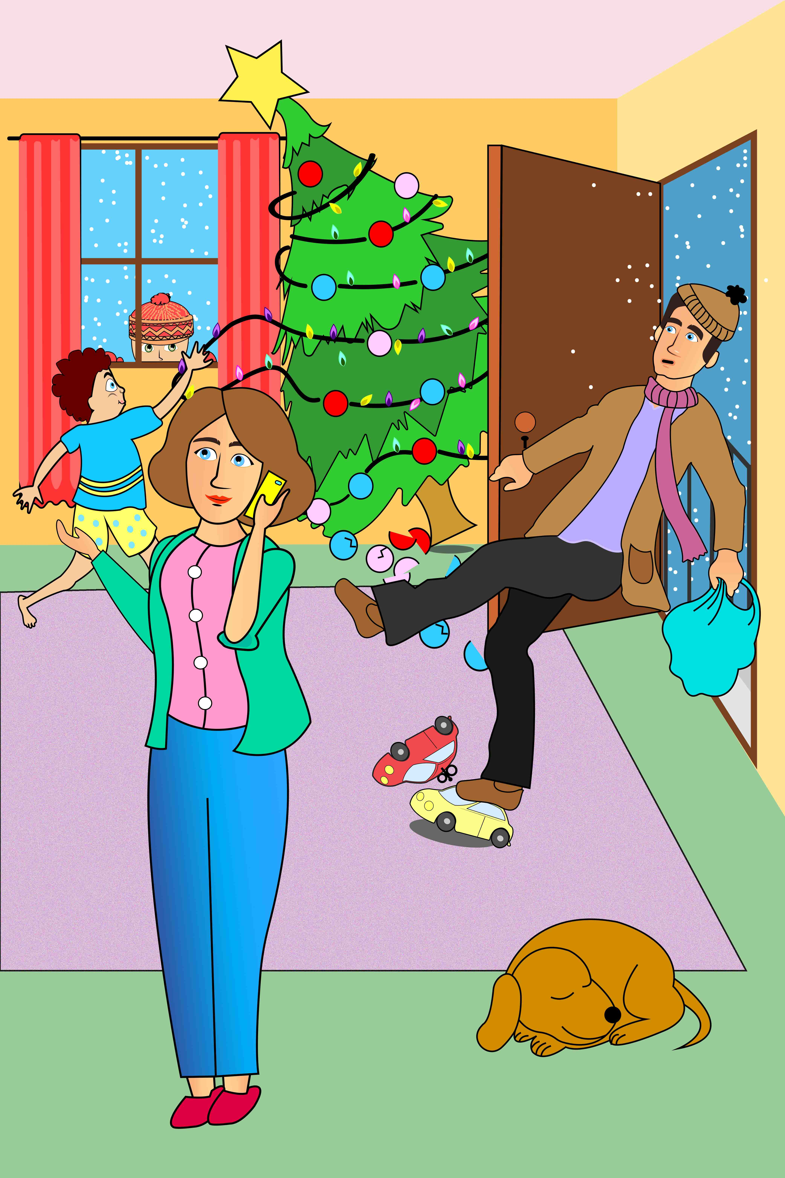
METHODOLOGY
Astronaut
Alarm clock
Ironing
selection of words and pictures
the principle of creating descriptive pictures
scientific version of the app – 60 words, 5 pictures
Photographing
Christmas

Slide 8



PROJECT PARTICIPATION CONDITIONS
RECORDING ORGANISATION (COVID)
STRUCTURED DATA COLLECTION PROCEDURE
inclusion criteria
motivational reward for project participants
social facilities and organisations
specialised equipment
database of candidates approached by recruiters
basic medical history
visual acuity test
informed consent
cognitive function test MoCA
questionnaires
recordings

Slide 9

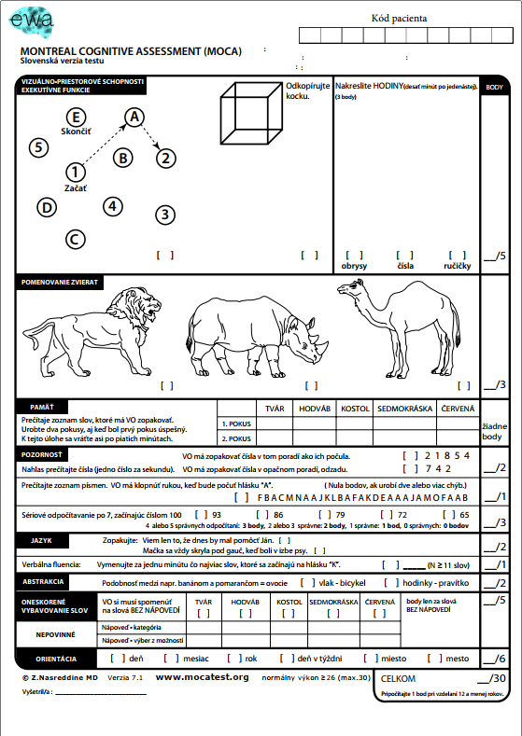

MoCA TEST
Montreal Cognitive Assessment

Slide 10

Data collection
Collection of verbal expressions on a specific topic
In the EWA project, descriptions of two types of images are used to record human speech:
naming of the subject/activity
description of the action scene

Slide 11

Database
More than 60 000 parameters per proband
1250 healthy people
161 people with symptoms of Alzheimer's disease
175 people with Parkinson's disease

Slide 12
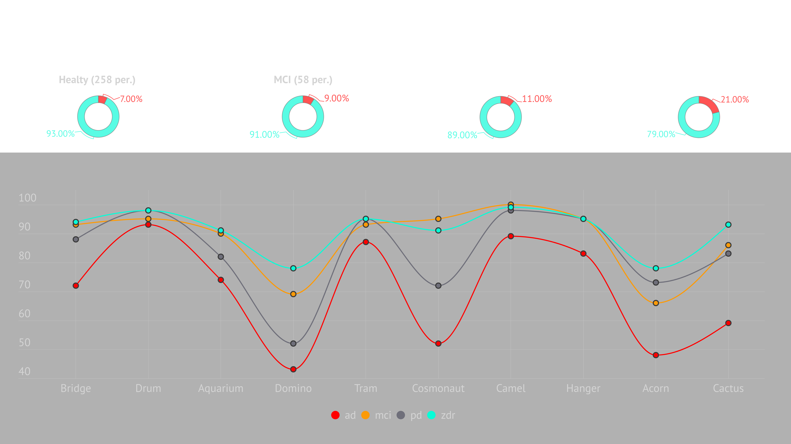

Slide 13

ACOUSTIC ANALYSIS
pauses
frequencies
reaction time
ready-made packages (xvector, trill, opensmile)

Slide 14
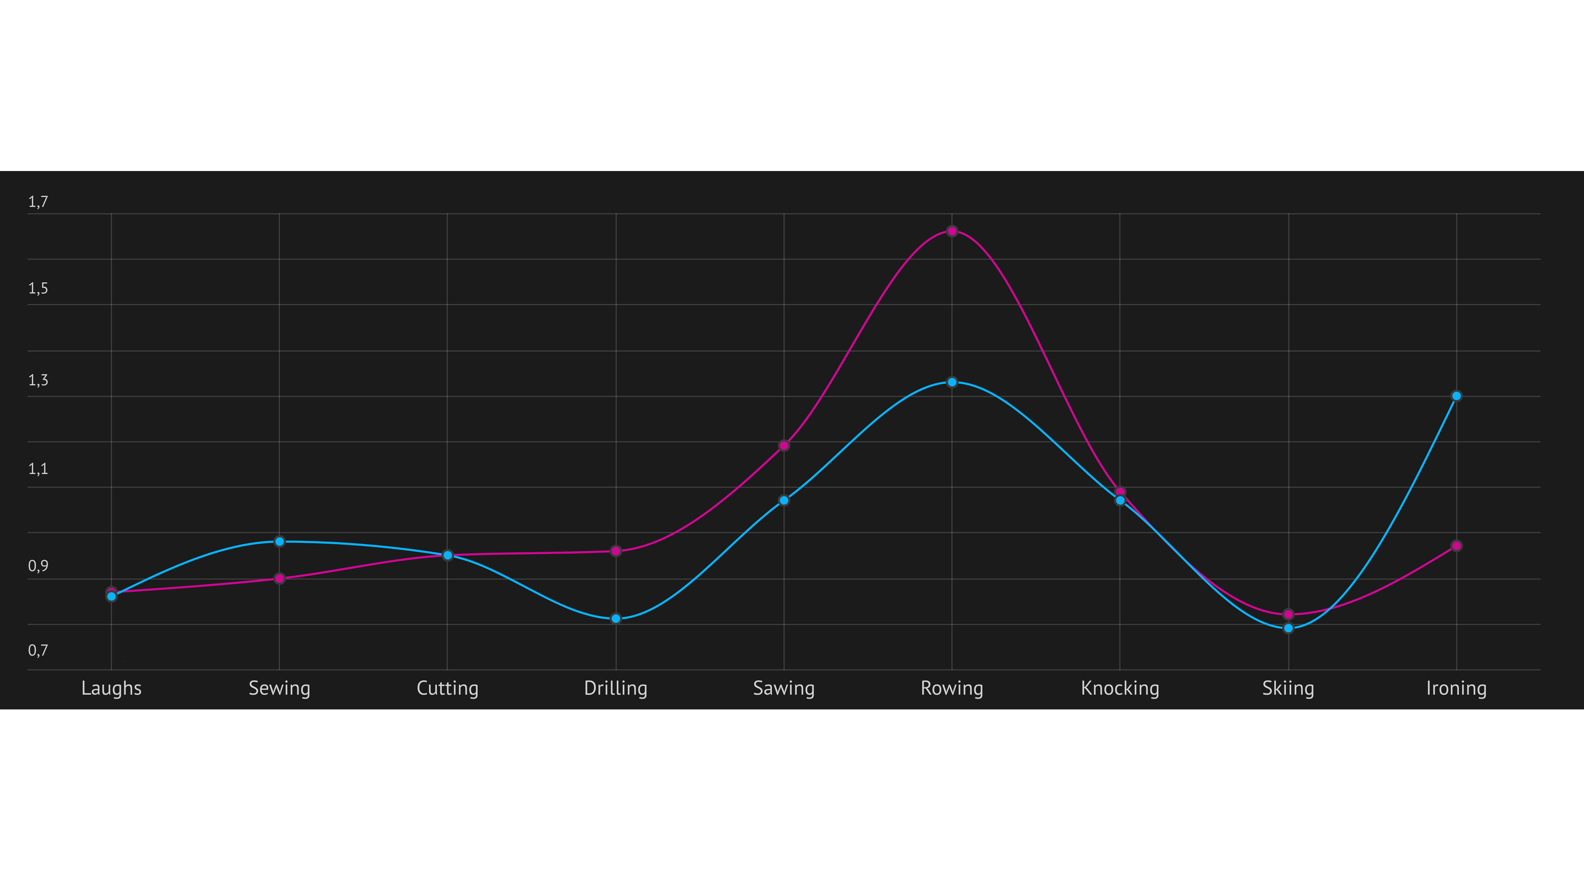

Slide 15

Examples of image descriptions
Healty
"A boy is standing on a chair stretching for a banana his chair is tipping over he's about to fall out of the tap water is flowing into the sink water is flowing out of the sink a cat is looking at it from the side the father has a sack in his hand he picked it up he wanted to hit a fly but he broke the lamp which is hanging there are two two shelves one is open half of the door there are partitions in between there's a bottle which is ..."
MCI
"Well in the kitchen child some there something dropped water water into the sink water is coming out of the sink water outside I see here another on the edge still some cat some cat and the gentleman in question smashed was slammed into the light with a ladle and again on the kitchen counter there is some there some some pot also something ..."
AD
"Well I don't know why he's knocking or banging on that light over there and oh there's the little boy again he's taking a banana out of that one but I think his chair slipped I don't know if he's going to fall off there's some more ..."

Slide 16

ASR
ASR (Automatic Speech Recognition) = Automatic Speech Recognition.
Transcription of vocal speech into text, indicating accompanying sounds such as laughter, fogging, coughing, pausing, etc.
The tool was prepared by the Institute of Informatics of the Slovak Academy of Sciences.
ANNOTATIONS

Slide 17
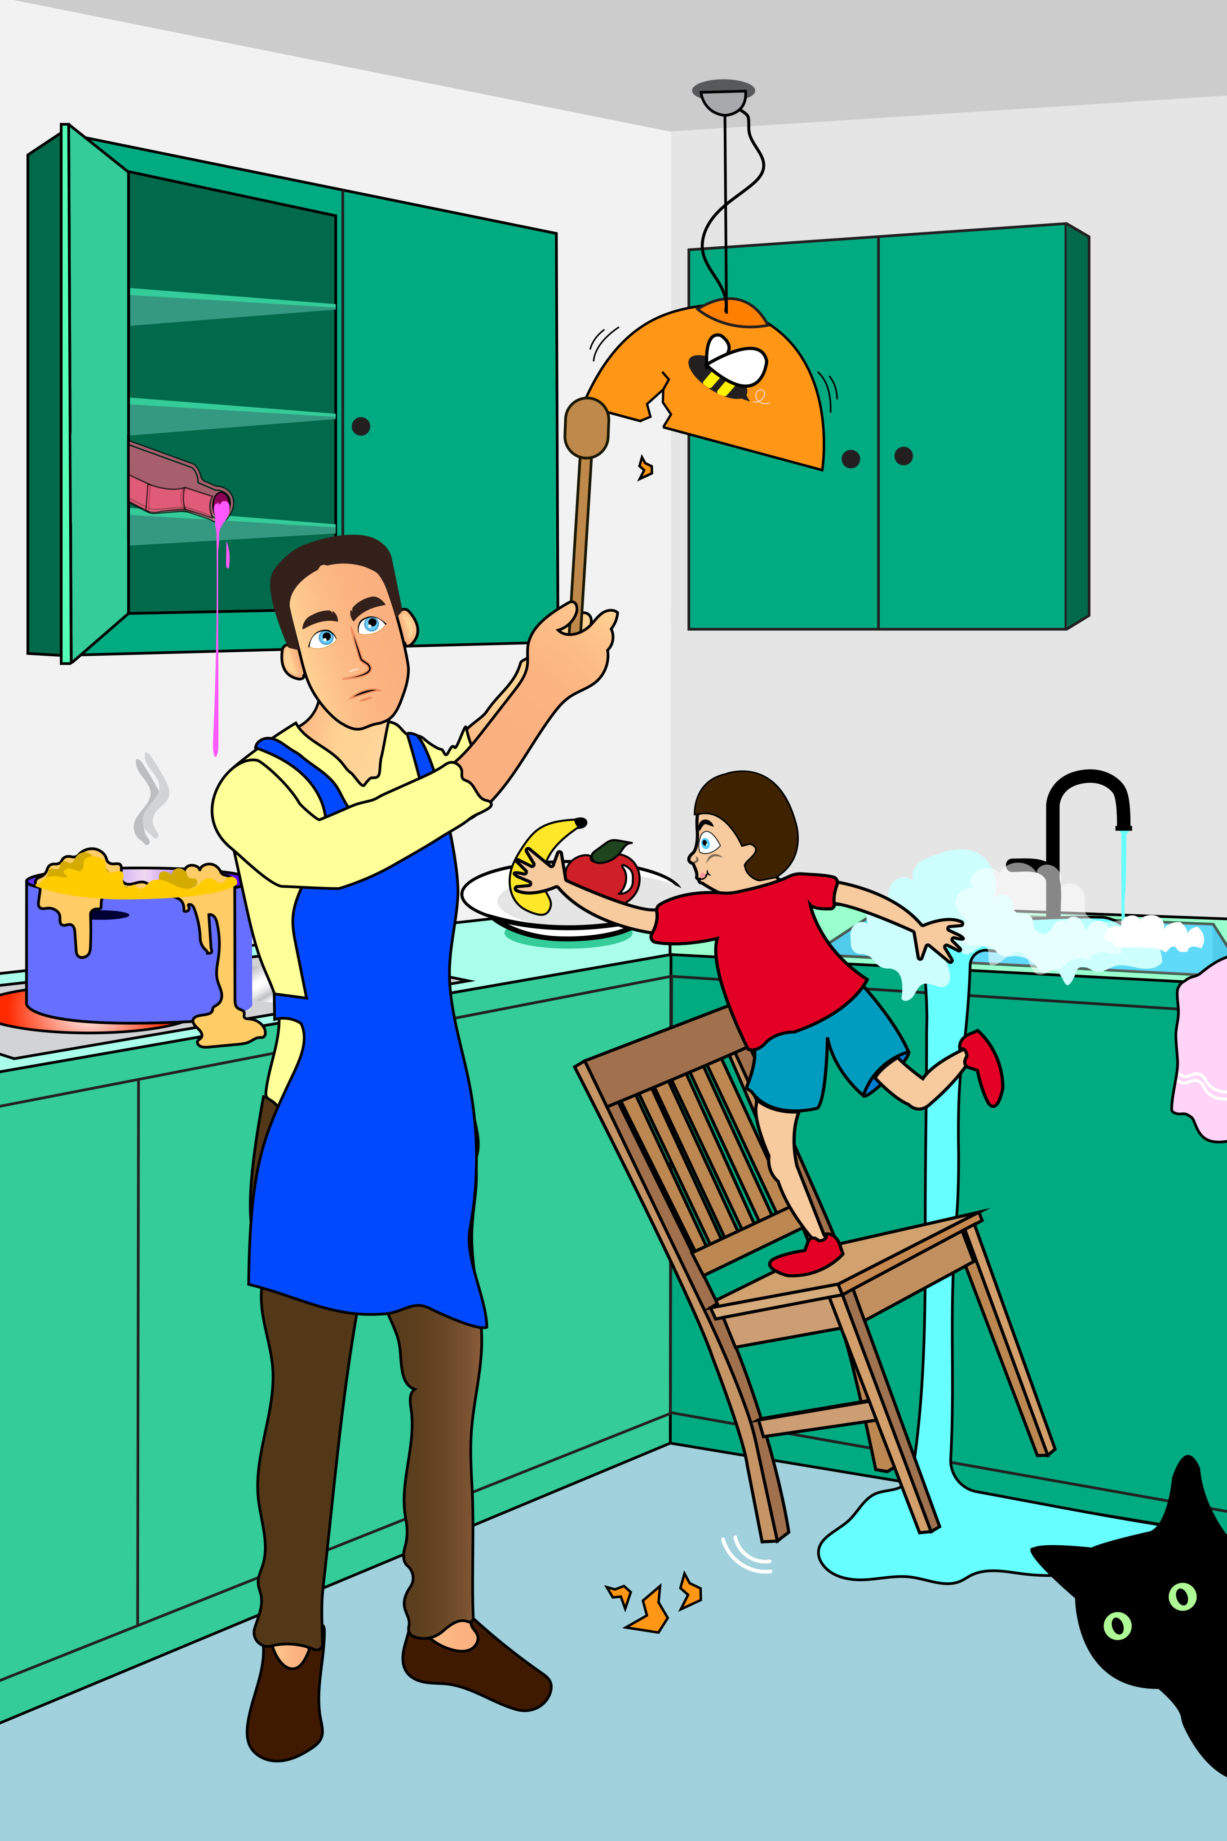
Example of NLP processing of a descriptive image
Text (ASR)
Tagging
Lemmatization
Stemming
Man in the kitchen well so it looks dangerous somehow
SSms1 Eu6 SSfs6 O PD PFns1 VKesc+ Dx PD
SSms1
Fig. 1. Descriptive image "Fruit theft"
verbal kind
case
paradigm
plural or singular
genus

Slide 18
Average occurrence of words by category

Slide 19
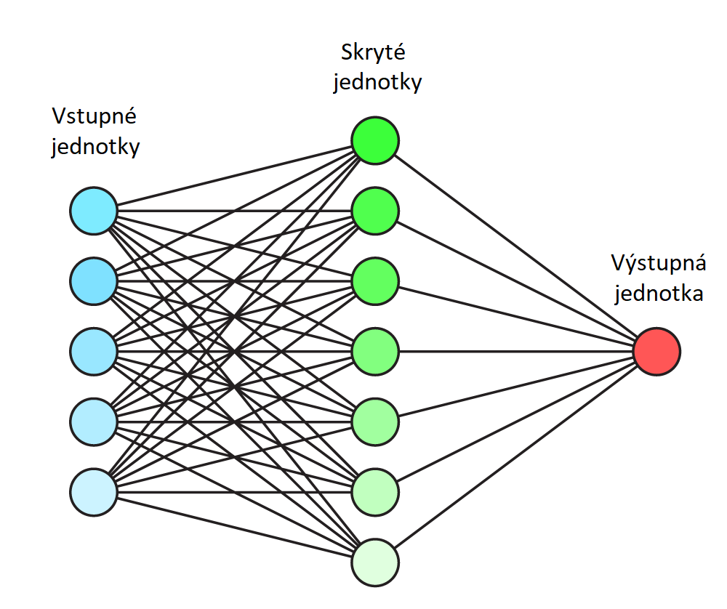
Neural network
Hidden layer
Input layer
Correctness of naming
Reaction time
Output layer
Number of pauses
Probability of disease symptoms
Age
…

Slide 20
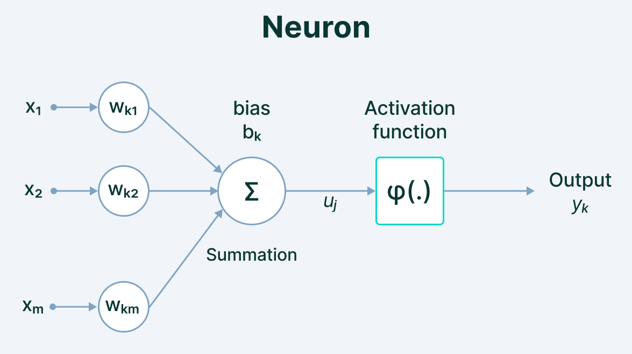
Explanation of a neural network

Slide 21



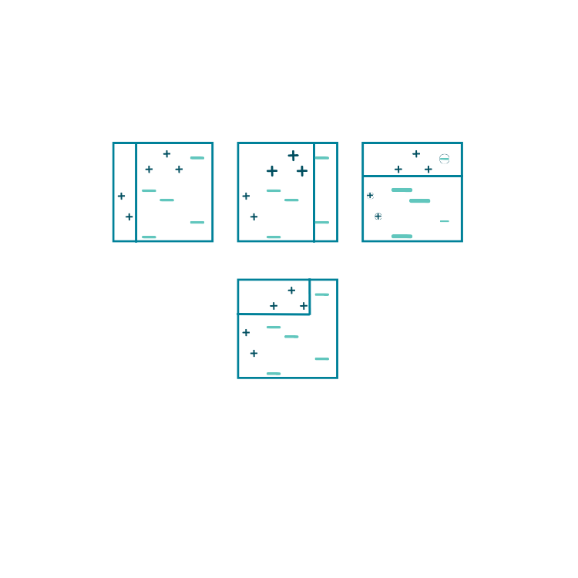
CLASSIFIERS
RANDOM FOREST
LOGISTIC REGRESSION
SUPPORT VECTOR MACHINE
ADAPTIVE BOOSTING

Slide 22

Methods of evaluation
Positive
Negative
Positive
TP | FP
FN | TN
Specificity = $\frac{TN}{(TN+FP)}$
Negative
Sensitivity = $\frac{TP}{(FN+TP)}$
Specificity = 95%
Sensitivity = 85%

Slide 23
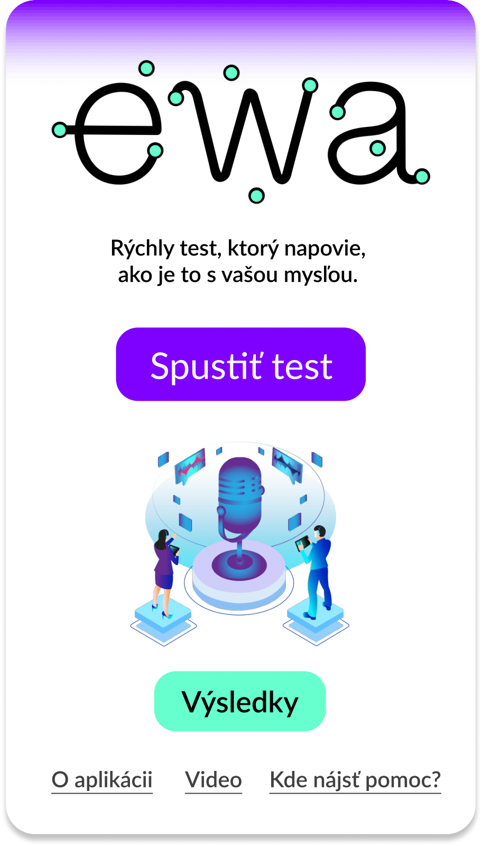
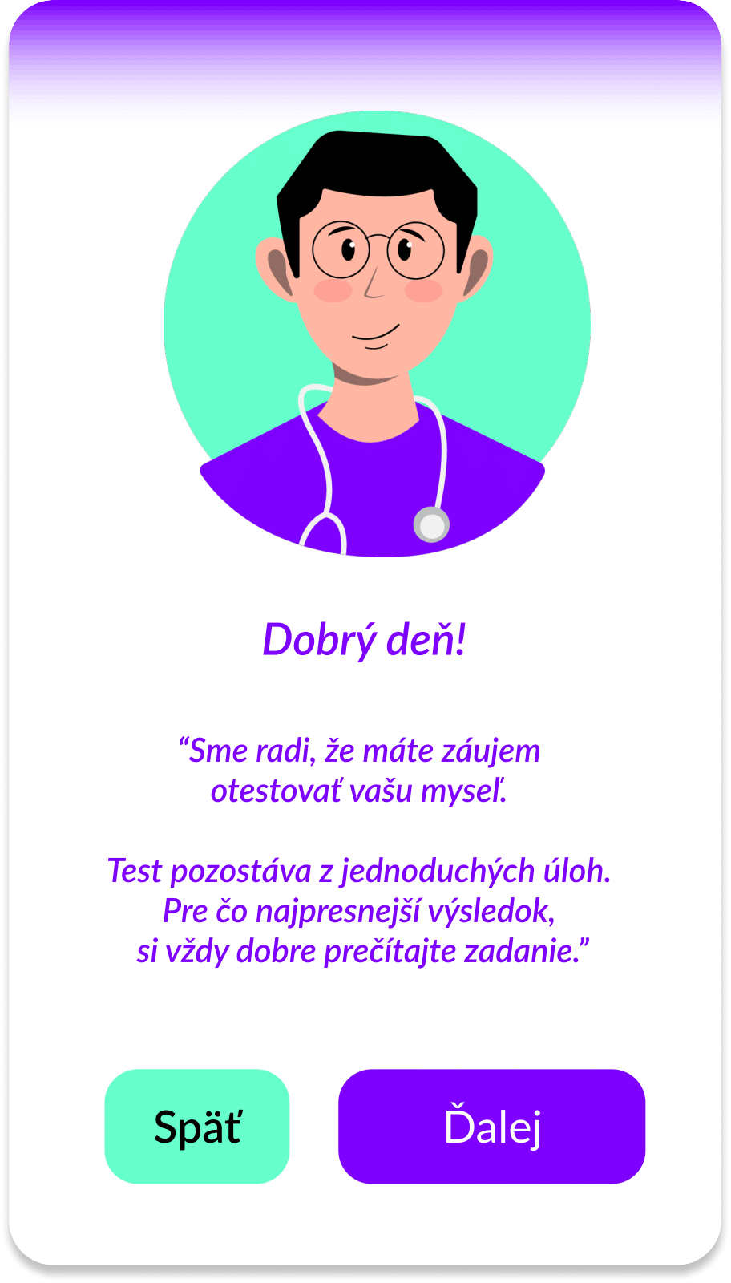
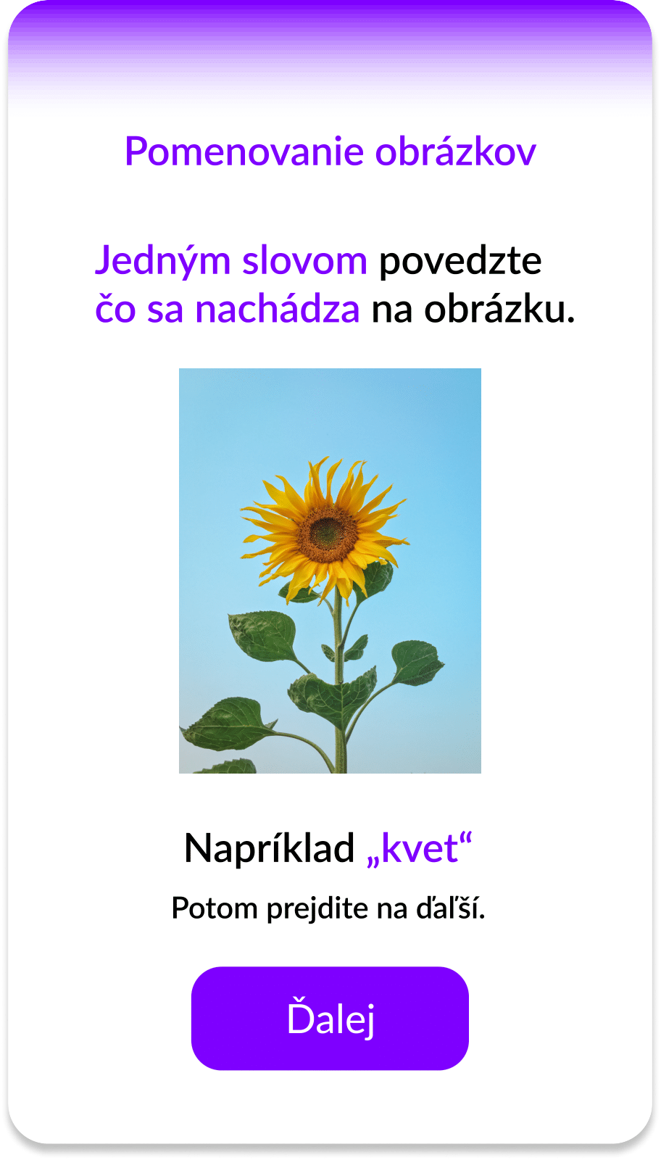
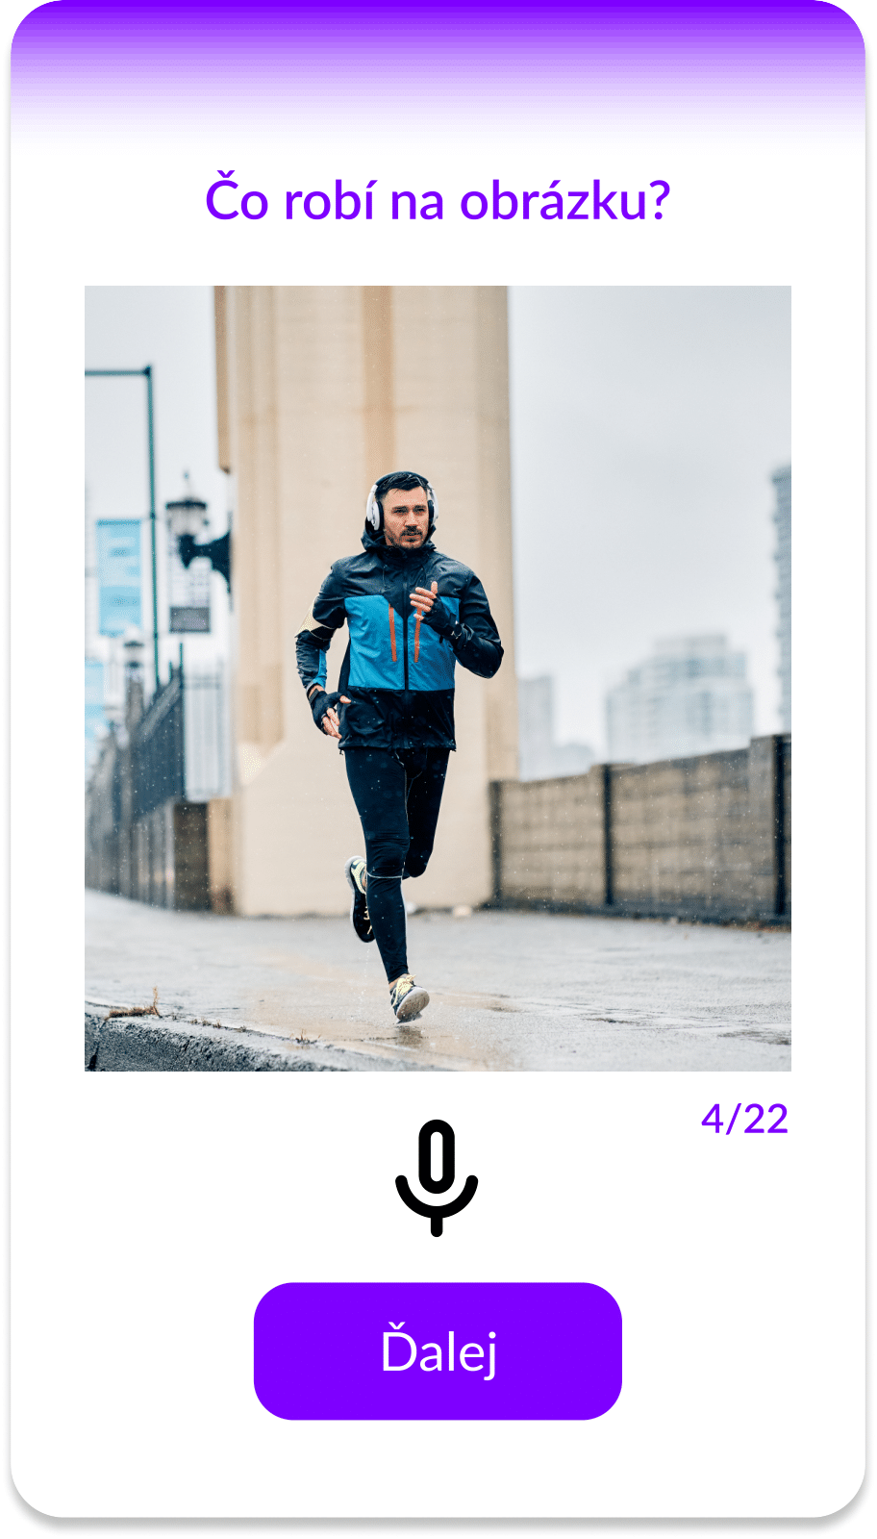
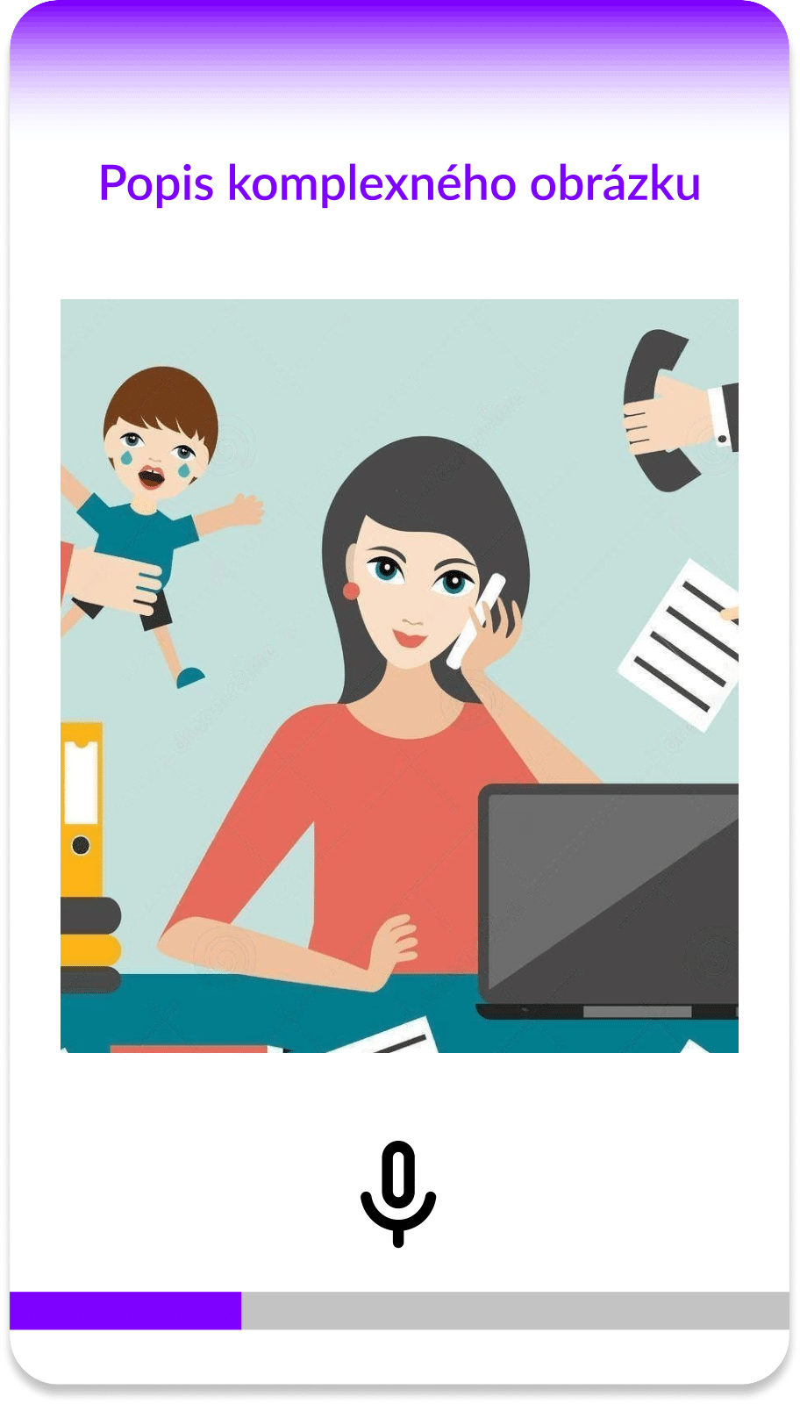
EWA PUBLIC APP

Slide 24

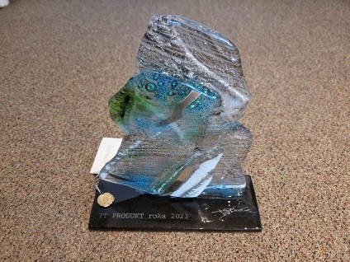
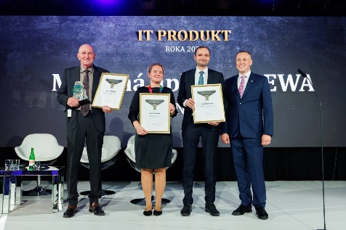
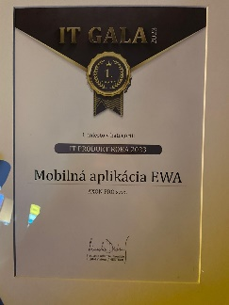
IT PRODUCT OF THE YEAR 2023
At the 21st edition of the prestigious IT GALA event, which took place on 19.10.2023 in Bratislava's Edison Park, we received the IT PRODUCT OF THE YEAR 2023 award.

Slide 25
Protect the treasure you carry in your head: memories and a healthy mind

Slide 26


THANKS FOR YOUR ATTENTION!

